Slide 1
Seafloor Spreading & Magnetic Striping

Slide 2
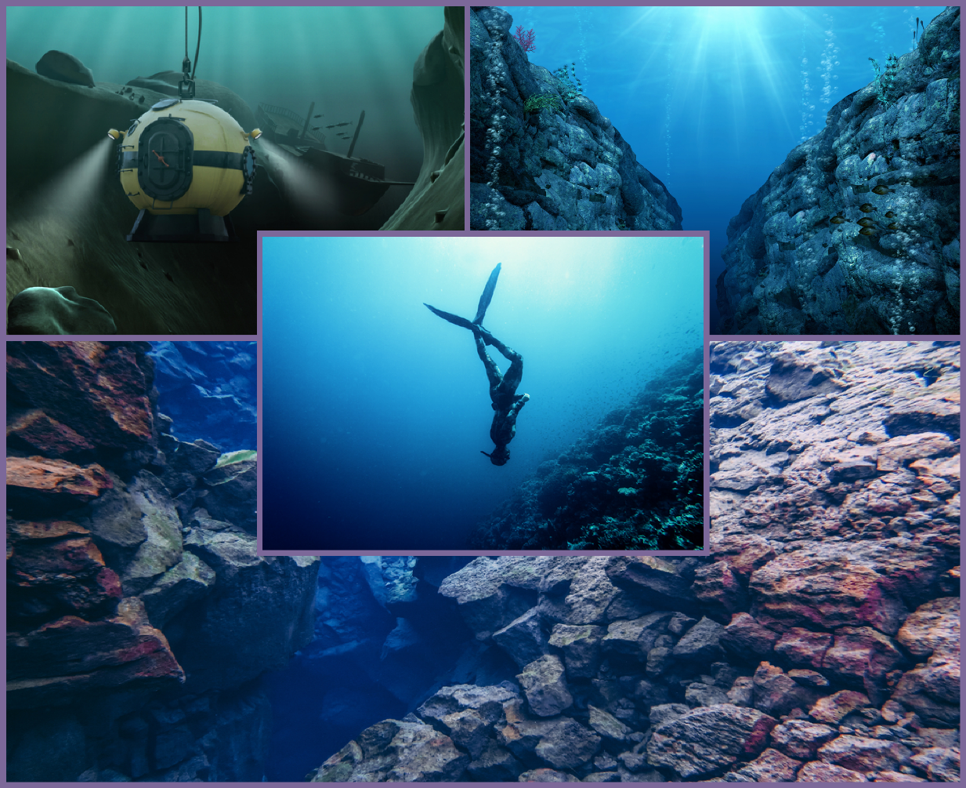
At the end of this voyage, you should be able to:
Outline the process of seafloor spreading.
Explain how magnetic striping occurs.
Discuss how this supports Wegener's theory of moving continents.

Slide 3
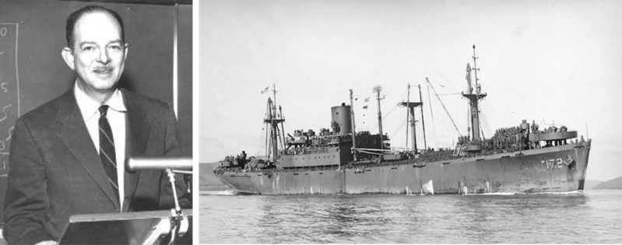
Meet Harry Hess.
So, who was Harry Hess?
Harry Hess was a naval officer during World War II. He then became a Professor of Geology at the prestigious Princeton University in the USA.
His work helped to take Wegener's ideas of continental drift and shape them into the modern theory we call plate tectonics. For a while, Hess was in charge of a ship called the USS Cape Johnson. This ship was meant for military use, but it could also use sonar to create images of the seafloor.

Slide 4
Sonar, also known as echo sounding, is the same technology that submarines use to "see" underwater.
It works by sending low-frequency sound waves into the ocean. When the sound waves hit an obstacle, they bounce back and can be picked up as an echo.

Slide 5
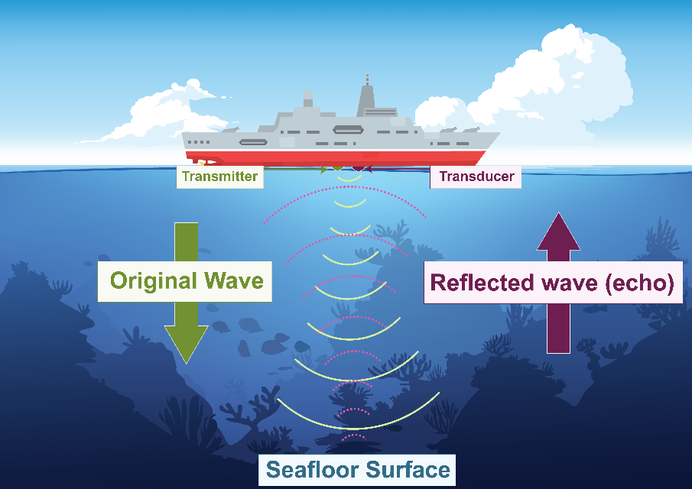
What could Hess do by recording echoes?
Echo sounding is the key method scientists use to map the seafloor today. Echo sounders aboard ships have components called transmitters and transducers.
Transmitters send a "cone" of sound waves down to the seafloor, which reflects back to the ship that is picked up by transducers.
These transmitters and transducers on Hess' ship allowed him to work out how deep the seafloor was at different points.
Using that data, he could draw an accurate map of the bottom of the ocean. At the time Hess performed these recordings, few people had ever attempted this before.

Slide 6
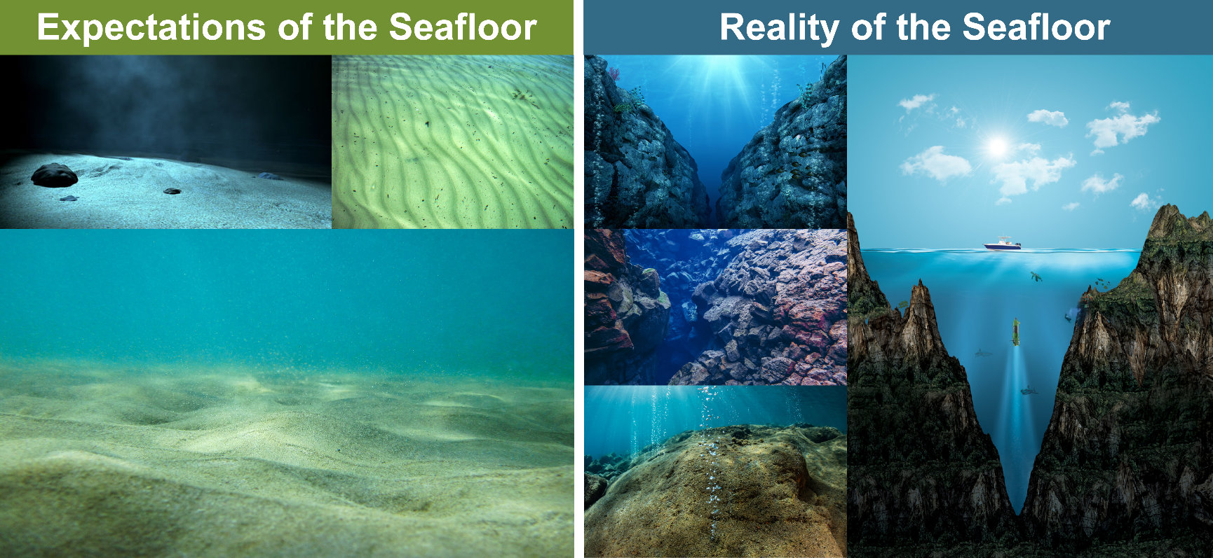
People expected the seafloor to be a fairly boring place. It's just flat and sandy, right?
Hess found that the seafloor is actually a weird and wonderful place!
He found trenches up to 11 kilometres deep in the Pacific Ocean. He also saw huge mountain ranges hidden under the water, and even active volcanoes!

Slide 7
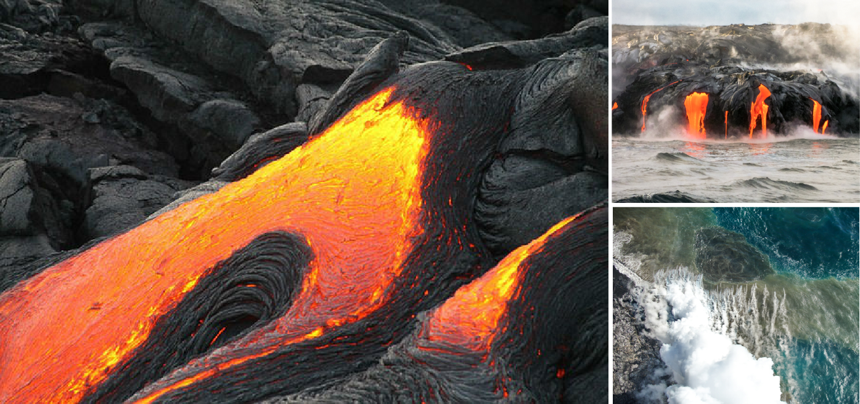
The most amazing thing Hess found was that the oceans appear to be growing!
According to his book, The History of Ocean Basins, the seafloor is made of a volcanic rock called basalt, a type of igneous rock.
The volcanoes he found lined up in rows known as mid-ocean ridges.
They bring molten rock up from the Earth's mantle, which cools and crystallises to form new basalt. This process adds rock to the oceanic crust.

Slide 8
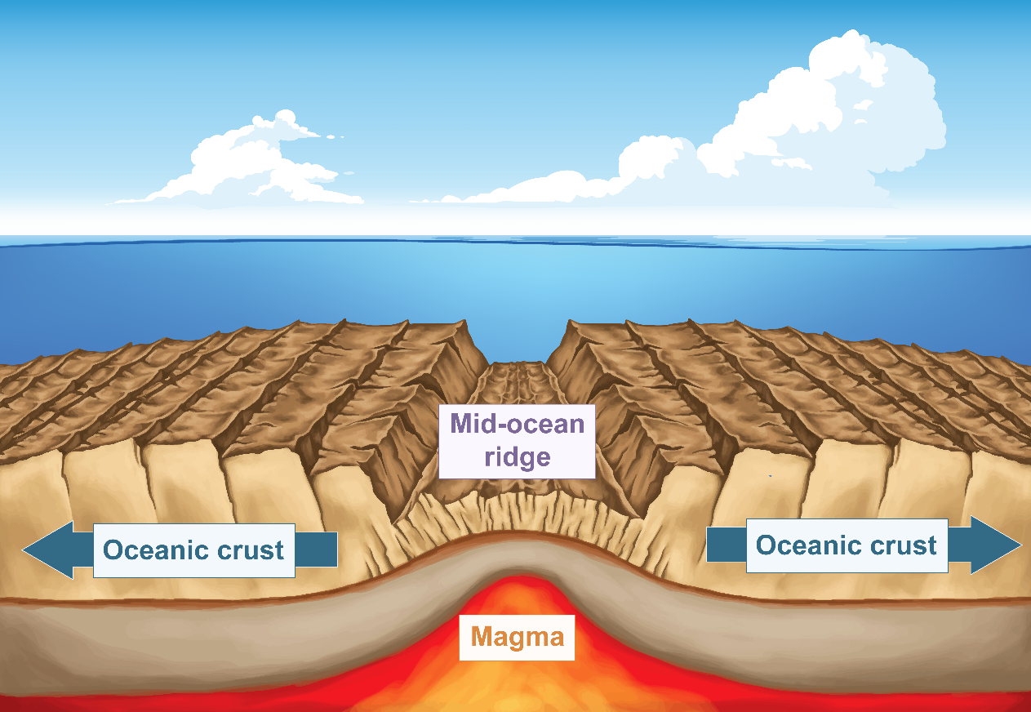
Over time, as more and more basalt is produced, the seafloor spreads out on either side of the mid-ocean ridge that is producing it.
This process is called seafloor spreading.
The diagram below shows a cross-section through a mid-ocean ridge. A body of magma underneath the ridge is erupting into the ocean, producing lava that is then chilled to form basalt.
The basalt is added to the oceanic crust on either side, which causes it to "grow" and spread away from the ridge, as shown by the blue arrows.

Slide 9
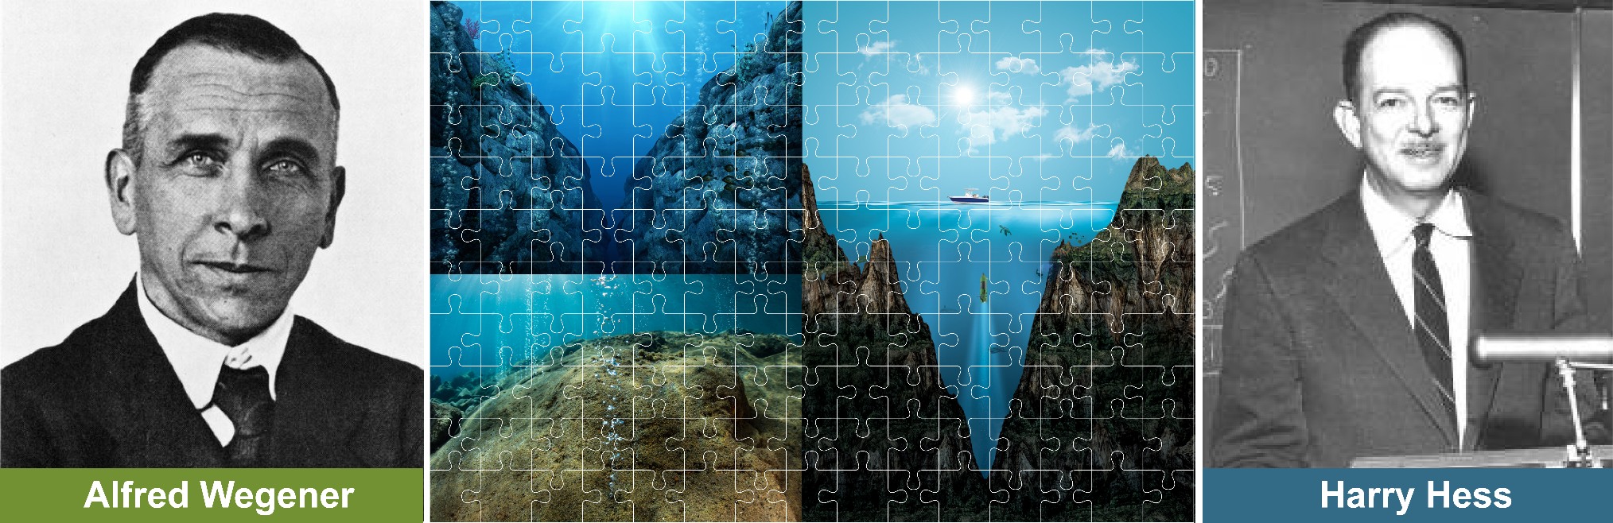
Seafloor spreading explains the movement of continents that Alfred Wegener talked about.
If an ocean exists between two continents, and the ocean is expanding, those continents must be moving away from each other.
This is the mechanism that Wegener's theory was missing!
Unfortunately, Wegener passed away a few years before Hess' research was published, so he never got to see his theory proven right.

Slide 10
To study the seafloor in more detail, other techniques were employed by scientists.
One of the most revealing techniques depends on magnetism and the Earth's magnetic field.
A magnetic field is an invisible force field that applies a force to any magnetic material.
For instance, the Earth's magnetic field can pull on a compass needle to make it point northward. This field surrounds the entire planet and has been there for billions of years!

Slide 11
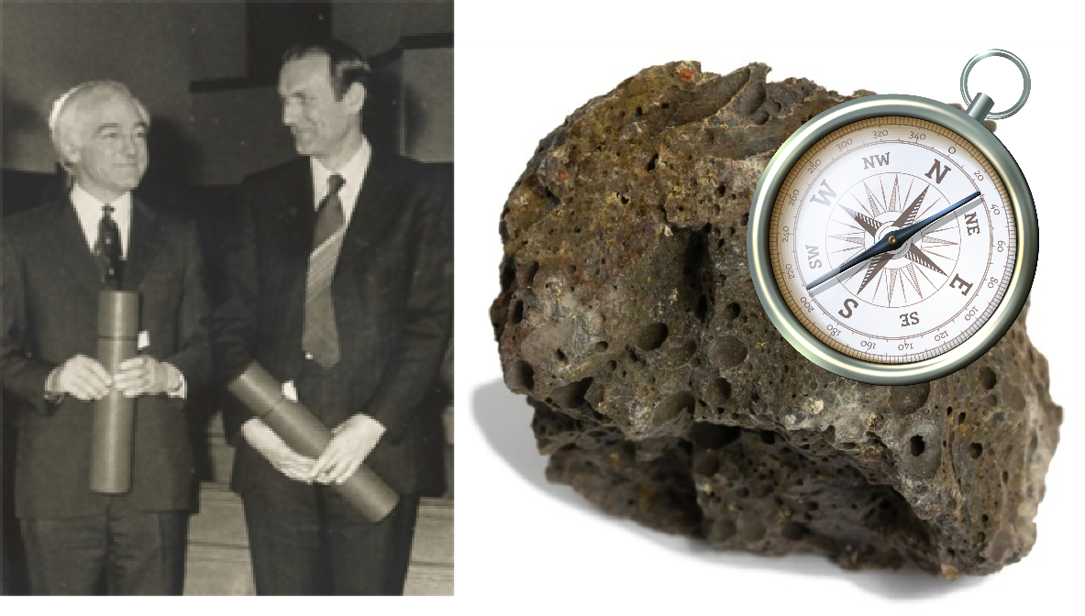
Drummond Matthews and Frederick Vine
Just after the work done by Harry Hess, two men called Drummond Matthews and Frederick Vine came along.
They were interested in magnetism in rocks. It turns out that volcanic rocks, such as basalt, record the polarity of the Earth's magnetic field. In other words, they contain crystals that point to magnetic north. When the basalt cools down from a molten state, those crystals are frozen in place and are all stuck pointing in the same direction. It's like the rock has its own compass inside!

Slide 12
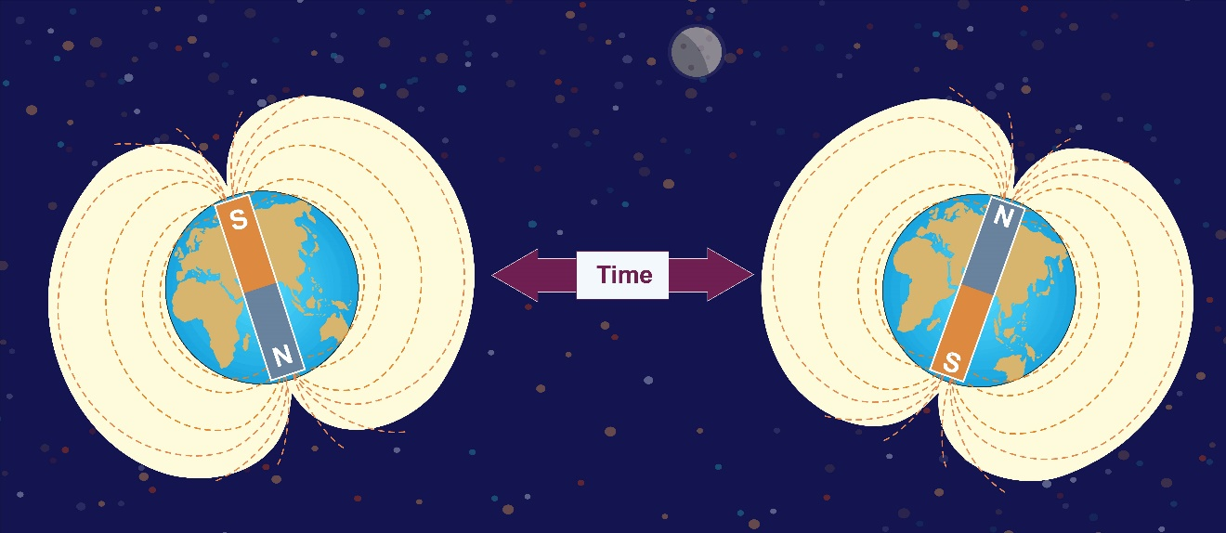
Rock records show us that the Earth's north and south poles have swapped places many times during the past.
This means that rocks formed at different times have their magnetic crystals pointing in opposite directions.
They can be used to determine the polarity of the magnetic field at the time they were formed!

Slide 13
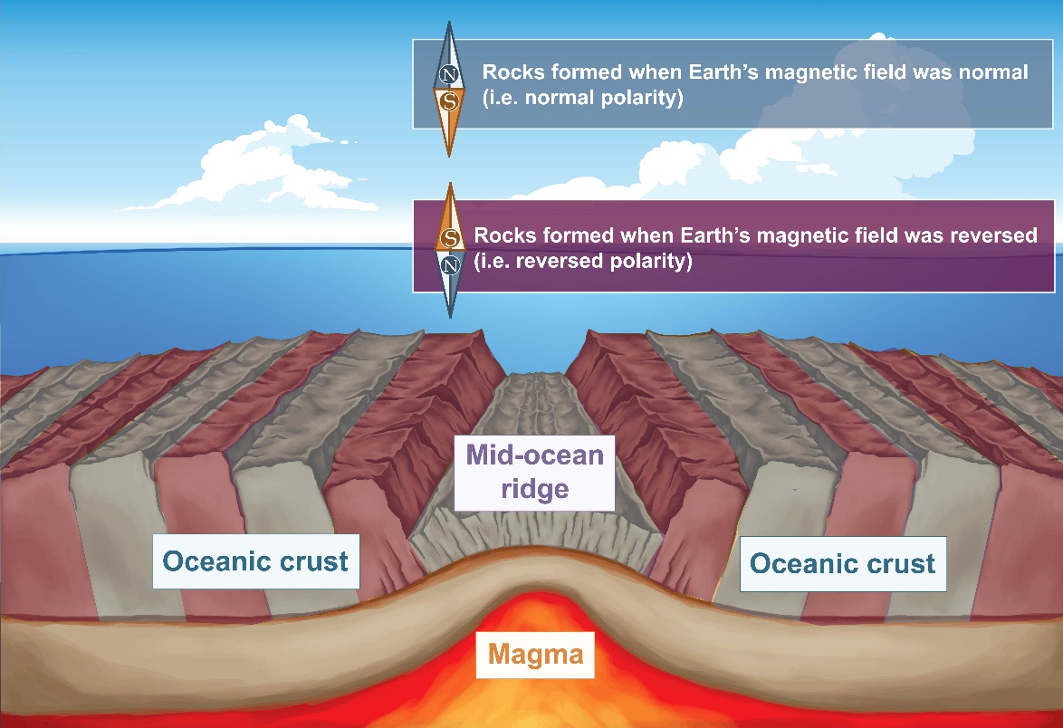
This effect is recorded in rocks as a pattern called magnetic striping.
Matthews and Vine found some interesting things about the pattern of magnetic stripes on the seabed:
The stripes are symmetrical on either side of the mid-ocean ridge.
The stripes are younger close to the ridge and older further away.
These features can only be explained by the theory of seafloor spreading!

